Slide 1
International Polymer Education in the Internet Age
C. K. Ober, Past President IUPAC Polymer, TM Division

Slide 2
IUPAC’s mission is to advance the worldwide aspects of the chemical sciences and to contribute to the application of chemistry in the service of Mankind.
Promotes norms, values, ethics of science
Advocates free exchange of scientific information and access of scientists
Addresses global issues as a scientific, international, non-governmental, objective body
Identify best practices

Slide 3
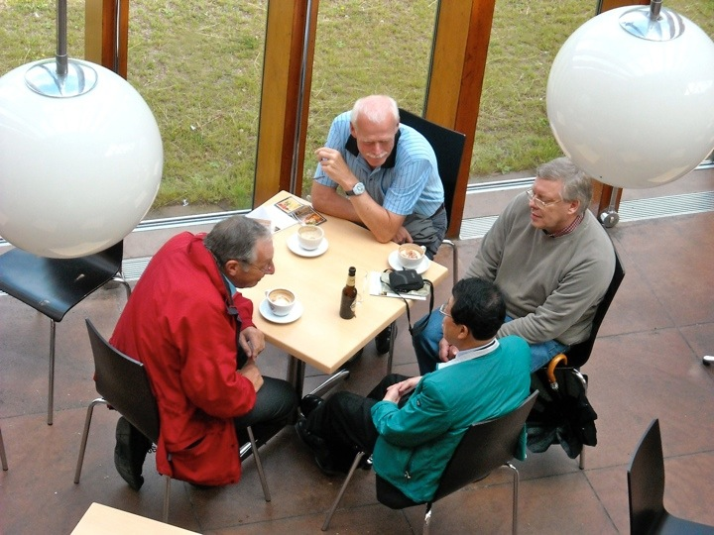
IUPAC Member Countries
NAOs and ANAOs

Slide 4
Major IUPAC Activities
Development of the Language of Chemistry
Nomenclature, Symbols, Terminology
Standardization of Chemistry Methods
Data Presentation
Study of Analytic Methods
Critical Evaluation of Physico-Chemical Data
Atomic Weights
Thermodynamic Data
Kinetic Data

Slide 5
Major IUPAC Activities (Cont.)
Data Exchange Standards for Computers and Instruments
Sponsorship of Conferences
Biennial IUPAC Congress (Torino, Italy 2007, Glasgow, Scotland 2009, San Juan, Puerto Rico 2011, Istanbul 2013)
More than 30 Specialized Symposia each Year (WPC 2014)
Chemistry Education
Industrial Safety and Environmental Programs
CHEMRAWN Conferences addressing Chemistry and Societal Impact

Slide 6
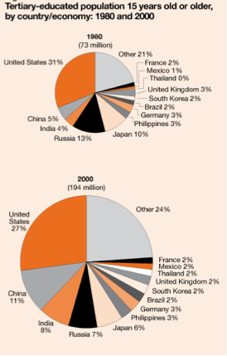
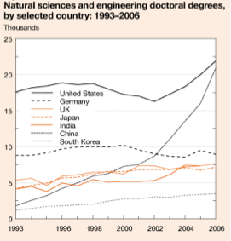
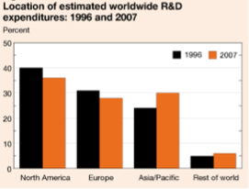
Where is chemistry being taught?
Source: National Science Foundation
How many are trained in polymer chemistry?

Slide 7
How can we reach the next generation?
Increasingly the developing world will be important center of chemistry and polymer chemistry
The internet can be a viable medium for reaching much of the world
The polymer division is taking many small steps to use this medium to reach out to:
disseminate educational materials
provide links to educational resources
engage people in polymer chemistry

Slide 8
Polymer Education Web Site
http://www.iupac.org/polyedu/
Polymer education CD
Links to other web sites
Educational material from PolyChar
Links to UNESCO-IUPAC polymer Workshop
Entry portal to international funding call
IYC activities
On Google, Bing, Yahoo it rates as one of (perhaps the) top sites for polymer education

Slide 9
Educational CD
Provided without charge by Prof. Richard Stein (UMASS) and the National Plastics Center for free distribution
Originally CD, but now downloadable files
Includes short videos and useful discussion on many commercial polymers
Works on PC and Mac

Slide 10
Leveraging Existing Efforts
Content suitable for high school teachers
IUPAC Gold Book (IUPAC)
Macrogalleria (USA)
Chemgapedia (Germany)
RACI (Australia)
Macro Group (UK)
PolyEd (USA)
AIM (Italy)
Spanish Polymer Group (Spain)
French Polymer Group (France)

Slide 11
Short Course Materials
Both short course attached to PolyChar conferences and UNESCO-IUPAC Postgraduate Course in Polymer Science create teaching material
Website either hosts this material or links to it
The content is aimed at advanced students studying polymers
Includes characterization, polymer physics, chemistry, etc.
More welcome

Slide 12
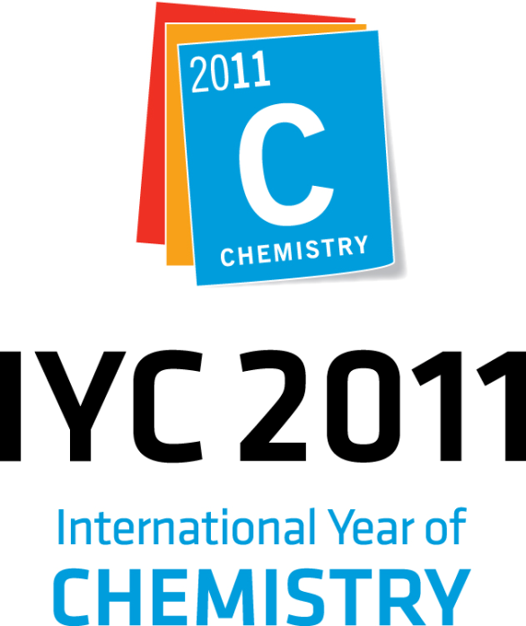
International Year of Chemistry 2011
On 30 December 2008 - The 63rd General Assembly of the United Nations has adopted a resolution proclaiming 2011 as International Year of Chemistry, placing UNESCO and the International Union of Pure and Applied Chemistry (IUPAC) at the helm of the event.
Visit and Bookmark this page
www.chemistry2011.org

Slide 13
International Year of Chemistry 2011
At its General Assembly in 2007 IUPAC unanimously approved a resolution in favor of the proclamation of 2011 as the Year of Chemistry.
The year 2011 marks the one-hundredth anniversary of the Nobel Prize in Chemistry awarded to Marie Sklodowska Curie, recognizing her discovery of the elements radium and polonium.

Slide 14
International Year of Chemistry 2011
An International Year of Chemistry will:
Serve as a focal point for activities by national chemical societies, educational institutions and non-governmental organizations
Enhance the understanding and appreciation of chemistry among the public
Promote the role of chemistry in contributing to solutions to many global problems
Build capacity by engaging young people with scientific disciplines
Serve as a catalyst for international cooperation.

Slide 15
International Funding Call
IUPAC is a standards/best practises organization
Funding agencies find great difficulty in enabling researchers in 3 or more countries to collaborate on jointly funded program
In honor of IYC, IUPAC Polymer Division is coordinating a pilot 3-country joint research funding call
Will help to establish best practises for funding agencies

Slide 16
Other IYC Activities
A polymer conference on each inhabited continent dedicated to polymers
Focus on younger polymer chemists and communicating the value of polymers to the public
To date Africa, Asia, Australia, Europe and North American conferences are being organized

Slide 17
Life without Polymers
Essay and video contest for young people interested in polymer chemistry
Ask them to consider what life would be like without polymers
Enlist them to educate the public about the value of polymers and polymer chemistry
Winners will invited to IUPAC conference

Slide 18
Video Interviews
The polymer community has great teachers and researchers who are passionate advocates for polymer science
By providing videos of these people we can provide teaching material and help better communicate the value of polymers to society
This activity will begin soon and should provide value after the IYC is complete

Slide 19
The IUPAC Prize for Young Chemists
Established to encourage young research scientists at the beginning of their careers.
Awarded for the most outstanding Ph.D. theses in the general area of the chemical sciences.
Learn more at www.iupac.org

Slide 20
Multi-lingual Glossary
provides list of terms relevant to polymer science in different key languages
Increasing number of languages
Portuguese, Spanish, French, German, Czech, Chinese, Japanese, Polish, Italian
Limited list of terms - not dictionary

Slide 21
New Directions
Video lectures on topics in polymer chemistry
Lab experimental procedures
More languages
More interviews with key polymer scientists
Historical aspects of polymer chemistry
Doing what we do better

Slide 22
Summary
Polymer education needs to have not only a regional, but a worldwide emphasis
The IUPAC Polymer Division is addressing some of these needs through its website, International Funding Pilot Project and its IYC activities
Volunteers and advice welcome
What else should we do?

